Slide 1
Smart Customer Purchase Analytics & RECOMMENDATION SYSTEM
MENTOR: Dr N. Shirisha, Assoc.Prof.
BATCH NO: 12
TEAM MEMBERS:
2320030284 – N .V. Sumanth Reddy
2320030020 – P.Manikanta
2320030002 – S.Rahul

Slide 2
Table of contents
ABSTRACT
INTRODUCTION
EXISTING SYSTEM
PROPOSED SYSTEM
OBJECTIVES
LITERATURE SURVEY
SOFTWARE REQUIREMENTS
HARDWARE REQUIREMENTS
FUNCTIONAL REQUIREMENTS
NON – FUNCTIONAL REQUIREMENTS
SYSTEM ARCHITECTURE
UML DIAGRAM
ACTIVITY DIAGRAM
MODULE DESIGN

Slide 3
Review – 2 comments addressed
1.Modules of the project need to analyse
2.Tools /Requirements gather

Slide 4
ABSTRACT
The Smart Customer Purchase Analytics & Recommendation System is a data analytics project that focuses on understanding customer purchase behaviour using big data analytics techniques. In today’s digital retail environment, organizations generate very large amounts of transaction data. This data contains useful information about customer preferences, buying patterns, and product performance. However, without proper analysis, this data cannot be effectively used for business decision-making.
This project uses historical customer purchase data to perform data cleaning, data integration, and exploratory data analysis. Different analytical techniques are applied to study sales trends, customer
segmentation, product-wise performance, and purchasing frequency. Data visualization tools are also used to present the results clearly through graphs and charts such as sales trends, category-wise revenue, and customer spending patterns.
In addition, a simple rule-based recommendation method is implemented to suggest products based on customer’s past purchases and frequently bought items. The system helps in identifying high-value customers, popular products, and possible cross-selling opportunities. Overall, this project shows how big data analytics and data visualization support data-driven business decisions and act as a basic foundation for intelligent recommendation systems in real-world retail applications

Slide 5
Introduction
• Background: Growth of digital retail & big data
• Large volumes of transaction data generated daily
• Businesses need analytics for better decisions
• Problem: Raw data is not useful without analysis
• Application: Retail analytics & intelligent
recommendations

Slide 6
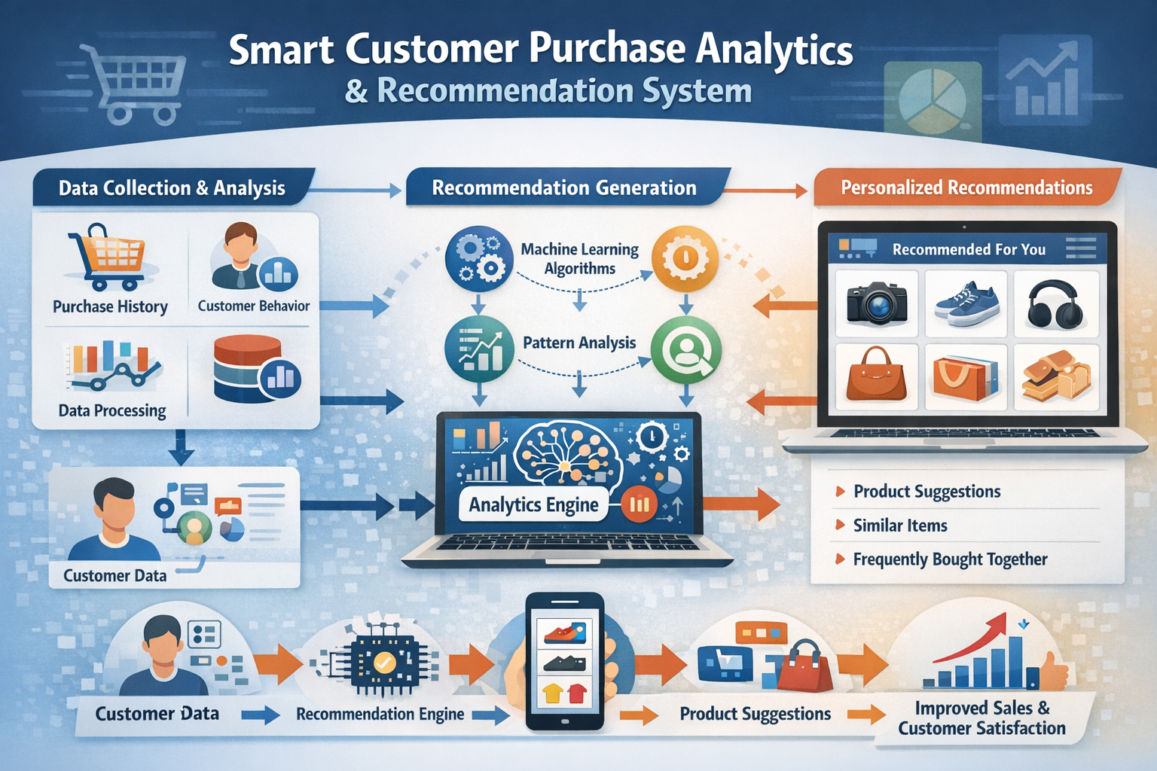
Existing system
In many traditional shopping platforms:
Recommendations are manual or based only on simple filters
Systems do not deeply analyze customer behavior
Customers must search products manually
Personalization is very limited
Example: Basic recommendation like “Top Selling Products” or “Popular Items” without analyzing individual customer preferences.

Slide 7
Proposed system
Our goal is to build a smart and efficient recommendation system that analyzes customer purchase behavior and suggests relevant products automatically. The system uses techniques from Machine Learning and Data Analytics to provide personalized recommendations to users.
The main purpose of this system is to continuously analyze customer purchase data and identify buying patterns in order to recommend products that match customer interests.
We use data analytics and recommendation algorithms to automate the process of product suggestion and customer behavior analysis. The system collects purchase history, processes the data, and generates recommendations based on patterns and similarities among customers.
The trained recommendation model can be integrated into an online shopping platform and deployed using modern development frameworks such as Flask or Django.
This recommendation system helps businesses improve product discovery, increase sales, and enhance customer satisfaction. It also reduces manual effort in analyzing customer data and makes the decision-making process more efficient.
The solution helps the system quickly adapt to changes in customer preferences and purchasing trends, ensuring that the recommendations remain relevant and useful.

Slide 8
Objectives
The main goals of the project are:
Analyze customer purchase history
Identify buying patterns
Predict future purchases
Recommend relevant products
Improve customer satisfaction and increase sales

Slide 9
Software requirements
Below are the software requirements for application development:
1. Python IDE(VSCode)
2. MySQL
3. GitHub
4. Flask
5. PostMan
6. AWS
7. Google Chrome

Slide 10
Hardware requirements
The hardware requirements for developing and running the Smart Customer Purchase Analytics & Recommendation System application are as follows:
CPU – Intel i3 processor or higher
RAM – 4 GB or higher
Storage – 20 GB or higher (to store datasets, application files, and system resources)
Operating System – Windows 10 or higher / macOS / Linux
Internet Connection – Required for accessing cloud services, APIs, and database
Display – Standard monitor for application development and testing

Slide 11
FUNCTIONAL requirements
User Registration and Login
Product Browsing
Customer Data Collection
Purchase History Management
Data Processing and Analysis
Recommendation Generation
Display Recommended Products
Admin Management
Database Management
Report Generation

Slide 12
Non - functional requirements
Performance:-The system should process customer data and generate product recommendations quickly to provide a smooth user experience.
Scalability:-The system should be able to handle an increasing number of users, products, and purchase records without affecting performance.
Security:-User data such as login details and purchase history should be protected using secure authentication and data protection techniques.
Reliability:-The system should operate consistently without failures and provide accurate recommendations to users.

Slide 13
Literature survey
S. No | Name of the research paper | Author name | Technologies used | Advantages/ Disadvantages
1 | A Recommendation System for E-Commerce Products Using Collaborative Filtering Approaches | Neelamadhab Padhy Sridev Suman T. Sanam Priyadarshini Subhalaxmi Mallick | Collaborative Filtering Algorithms User–Item Interaction Matrix Cosine Similarity Machine Learning Techniques Python / Data Mining Tools Dataset preprocessing | Advantage: Provides personalized recommendations using user behavior; Disadvantage: Suffers from cold-start and data sparsity problems.
2 | Predicting Consumer Behavior in E-Commerce Using Recommendation Systems | Pradeep Kumar Singh Ritu Sharma Amit Verma | Machine Learning Algorithms Customer Behavior Analytics Data Mining Techniques Predictive Modeling Python / R Recommendation Engine | Advantage: Helps predict customer purchase patterns; Disadvantage: Accuracy depends heavily on large and high-quality historical data.
3 | A Content-Based Recommender System with Consideration of Repeat Purchase Behavior | Chia‑Hung Lai Der‑Jiang Jwo | Content-Based Filtering User Purchase History Analysis Feature Extraction Similarity Measurement Algorithms | Advantage: Uses individual purchase history effectively; Disadvantage: May recommend only similar items and lacks diversity.

Slide 14
Thank you
S. No | Name of the research paper | Author name | Technologies used | Advantages/ Disadvantages
4 | Developing Recommender Systems with the Consideration of Product Profitability for Sellers | Gediminas Adomavicius Alexander Tuzhilin | Recommendation Algorithms Profit-Aware Recommendation Models Data Mining Utility-Based Recommendation Decision Support Systems | Advantage: Improves seller profit along with recommendations; Disadvantage: May prioritize profit over customer satisfaction.
5 | Supercharging Recommender Systems Using Taxonomies for Learning User Purchase Behavior . | Alexandros Karatzoglou Linas Baltrunas Yehuda Koren | Taxonomy-Based Recommendation Matrix Factorization Latent Factor Models Machine Learning Techniques Data Mining Algorithms | Advantage: Improves recommendation accuracy using product category hierarchies; Disadvantage: Requires well-structured taxonomy data and complex implementation.
6 | Distributed Vector Representation of Shopping Items, the Customer and Shopping Cart to Build a Three-Fold Recommendation System | Omid Kardan Maryam Ebrahimi Hadi Fakhraei | Deep Learning Techniques Vector Embedding Models Neural Networks Representation Learning Purchase Pattern Mining | Advantage: Captures complex relationships using deep learning embeddings; Disadvantage: Requires large datasets and high computational resources.

Slide 15
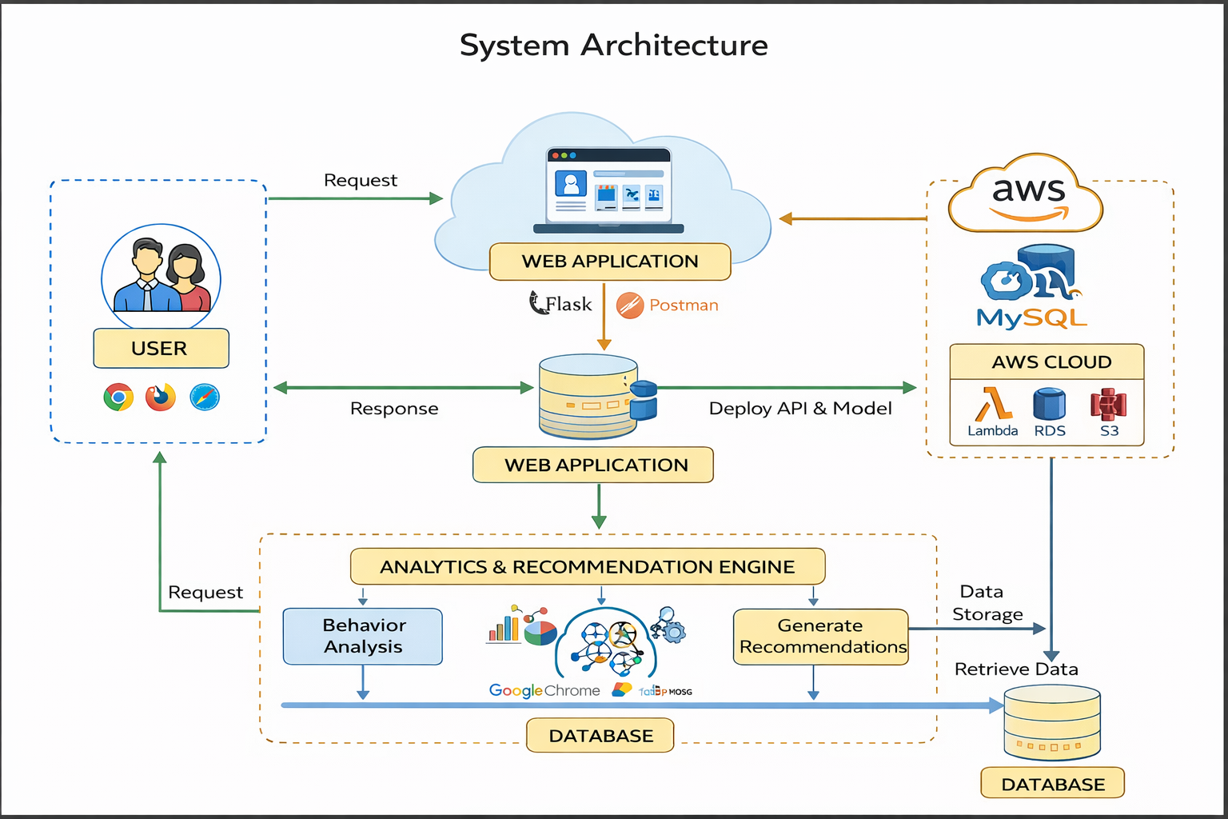
System Architecture

Slide 16
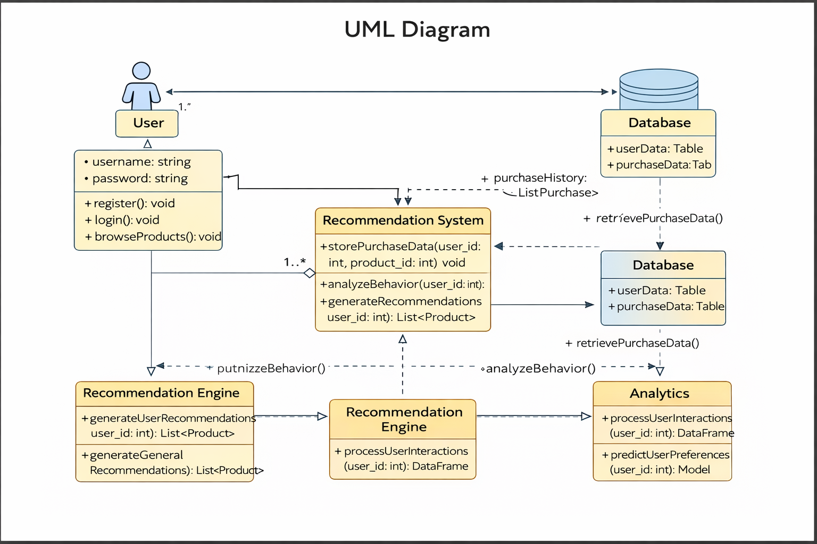
Uml diagram

Slide 17
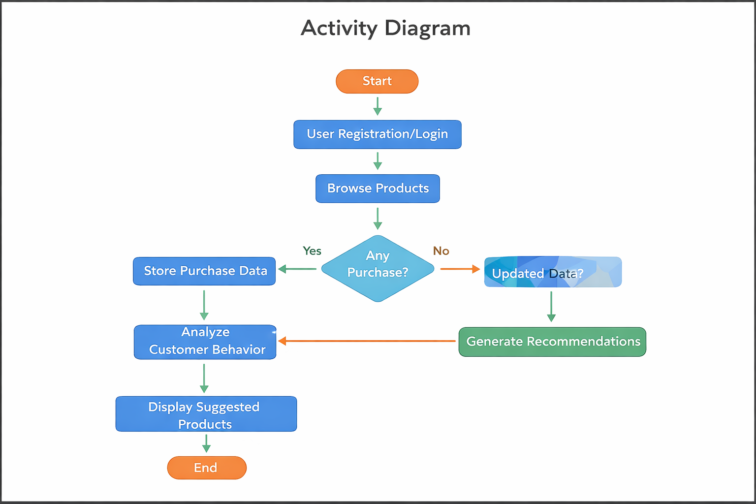
Activity diagram

Slide 18
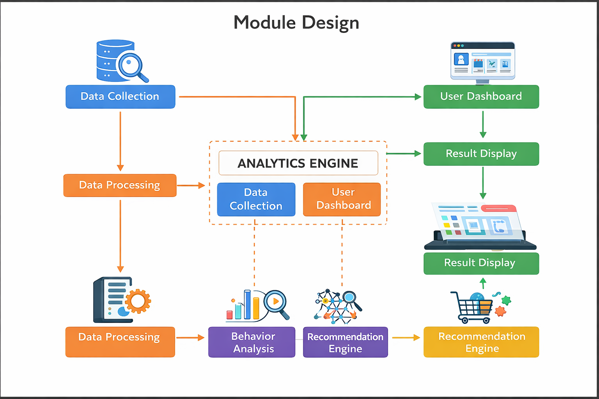
Module design

Slide 19


